Slide 1
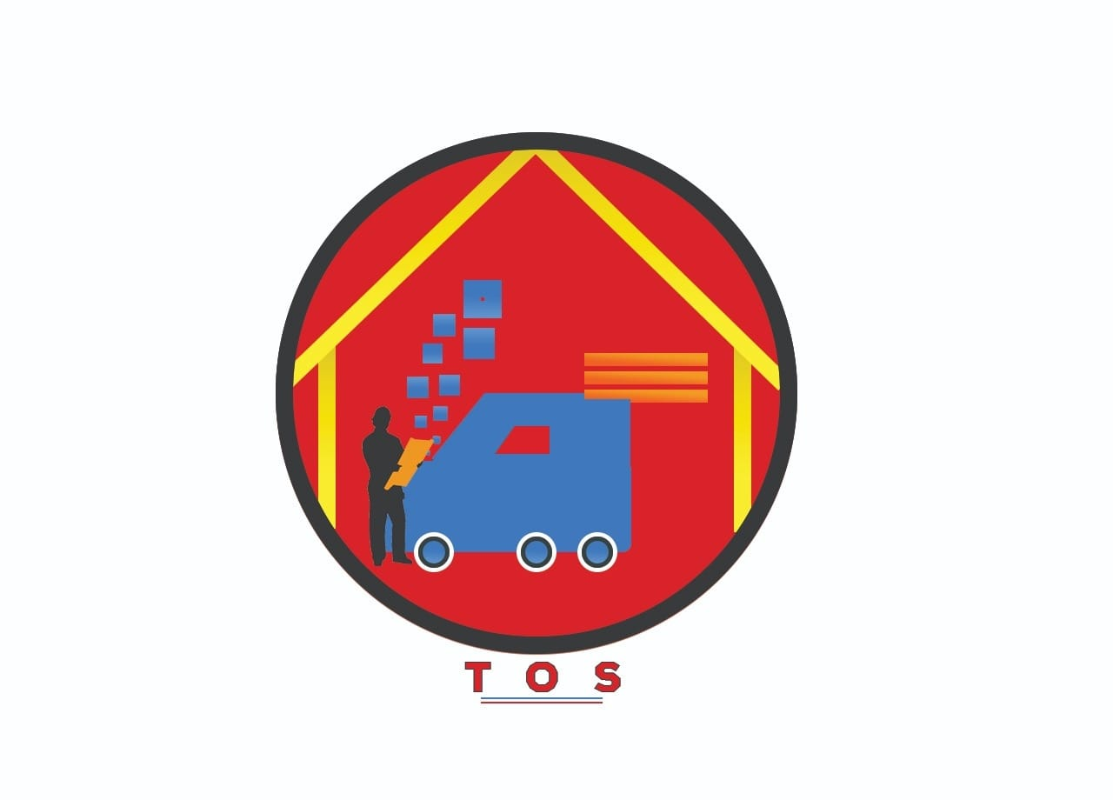
TILES ONLINE STORE PRIVATE LIMITED

Slide 2
INTRODUCTION OF COMPANY

Slide 3
NAME OF COMPANY :- TILES ONLINE STORE PRIVATE LIMITED
FOUNDER NAME :- SAMEER SONWANE
APPLICATION NAME :- TOS (TILES ONLINE STORE)

Slide 4
PURPOSE OF COMPANY:-
Providing the best services related to the online sale of tiles and ceramics products and helps customers to fulfill their essential needs of interior designs for their dream homes.
To create effective demand and supply of the products for making profits and helps to increase the market capitalization.
Customization of unique product design suitable for the interior of flats, house and other commercial and residential projects.
To connect more retailers and wholesale distributor for better quality products.

Slide 5
MISSION VISION AND VALUES OF COMAPNY

Slide 6
OUR MISSION :-
To provide best services to customers through innovative, creative designs with the help of user friendly online platforms so they can explore the different kind options in tiles and ceramics .
OUR VISION :-
To continue to provide unrivalled services and exceptional value for money to growing customer base.
To emerged as top brand and market leader in future .

Slide 7
OUR VALUES:-
Tiles online store passionately believes in providing better services to customer through user friendly online portals which describes the quality, design and textures of product and also focuses on creating the effective business with core values.
INTEGRITY:-
Our main focus to connect with customers with the transparency in communication and feedback through online portal.
We have the highest level of integrity of character for successful business.
QUALITY:-
We provide the highest quality of products and services and seek regular feedback for improvement.

Slide 8
Our main focus is to set an effective benchmark to judge self and subordinates on quality on an ongoing basis.
CUSTOMERS:-
To treat internal and external customers with characters.
We constantly work to delight customers.
AGILITY:-
Our main focus is to execute all the business task before timeline.
Our belief is to achieve more and more business goals in lesser time.
PARTNERSHIP:-
We believe in maintaining excellent relationship with retailers and distributor.
We seek active engagement with business partners.

Slide 9
PERFORMANCE :-
We believes in delivering the best business performance through the different kind of online platforms.
We are aware of business goals and constantly strive to achieve them.
DESCION MAKING:-
Our focus is to create an effective decision making for proper regulation in future demand and supply of products.
To execute proper plans for the expansion of business and increase market capitalization .
DIGITAL MARKETING PLATFORM:-
Digital marketing plays an effective role in the e-trading of good and services.
Gives an clarity to customer and business partners for effective business activity.

Slide 10
MARKET RESEARCH

Slide 11
CONSTRUCTION:-
In the current market research we have noticed that there are lot of construction work happening in Nagpur city. there are so many shops, residential and non residential sites houses, flats are built in huge manner which create effective demand for which helps to gain suitable profit. nowadays every middle class as well as rich class people want to built their houses and shops modern and it is our duty to helps them.
The Pradhan mantri awas yojna gives huge profit to people as the Nagpur is under developing city where construction work is rapidly increasing. in the current market research we have found that 35% of construction of houses are in final phase and 25% of people who are living in rented flats wants to built their dream houses but due to lack of money they are not able to built it that’s why the choose to live in rented flats. Other few percentage includes shops which are totally constructed.
In Nagpur city 35% of construction work is in final phase, form which the online business of tiles and ceramics products with huge demand create effective profit. this is based on door to door research method.

Slide 13
SALE OF PRODUCT IN MARKET CONSISTANCE:-
In current market research we found that most of people usually prefers the 2 x 2 shaped tiles for normal floors and 12 x 18 uses for bathroom wall tiles. in parking lots, preference is for 16 x 16 shaped tiles. according to the customer choice engineers and contractor install 4 x 2, 6 x 2 shaped tiles, same tiles has been useful for bathroom floors. in commercial shops the dark shade mat tiles are first preference. the granites are useful for shop counters for billing.
there are so many varieties of material has been used but the 2 x 2 shaped tiles are frequently being used by the contractor in city. this insight are based on the reviews shared by the local shop owners and house owners in the Nagpur city.

Slide 14
PROBLEMS OF MARKET

Slide 15
LACK OF SERVICES:-
The customers are facing problems due to lack of services as they want to proper quantity of materials as per their choice. This problem is not only related to tiles product but also in supply of granites, kaddapa, marbles products. Our main focus to make to sure this product services should be easily available to customers.
DATA OF STOCK MANAGEMENT:-
The retailers don’t have any online mode of records of stock management. the stock management is always difficult task to retailers and due to this improper management huge amount of stock becomes dead. sometimes there could be possibility of theft and that’s why our application could help them to maintain proper stock management.

Slide 16
CONNECTIVITY OF CONTRACTOR AND CUSTOMER:-
When the customer receives sufficient amount of material in proper time the next challenge to the customers is to do installation work and for that they need contractor and due to lack of availability they don’t have any project work left so the connectivity loses and they lost the contract.so our main focus is to connect the customer with contractor for the completion of work in particular period of time.
BIG CAPITAL FOR STARTING BUSINESS:-
Before starting of tiles business company must have necessary amount of capital from that the retailer can buy the old range tiles products because of that he cannot fulfill the needs of customers. To attract the customers the retailers use the tactics of Electronic display which cost heavy amount. So the company application helps the retailer to boost his business through online platforms.

Slide 17
CONCEPT OF CUSTOMIZATION:-
The customers have to explore the market for best range of tiles but after exploring the market, customers have to change his range of choices and have to buy the product available in market which is not according his expectation. Our main focus is to deliver the proper range of products to the customers based on their expectation through our application.
TRANSPORTATION:-
Transportation facility is one most important factor which plays vital role in any business activity. Needs of customers have to fulfill through proper connectivity so that we can provide the material within the expected time range and our company ensures to do that.
These are our problems we noticed through our market research and when we implement our activities according to all these factor we can also face new challenges that can solve through our application and we are passionate to explore more challenges through these kind of market researches.

Slide 18
SOLUTION OF MARKET PROBLEMS

Slide 19
LACK OF SERVICE :-
To provide best services to customers we have started the online platforms from that customer can fulfill his choice of products by own. Our application is totally free for customers from which they can place order of their selected material. The online platform functions as any other E-Commerce websites. These will helps us to put the variety of product range in front of customers these also includes the Granite, kaddapa, marbles, Sanitary items, Decorative goods which can provided by company.
This application helps to provide materials to customers. It also helps to connect all the retailers so that they can sell their product in online platforms and for that they will be provide admin planner so that they can put their products in our application which helps them to decide their best range of price. When the customer order particular product immediately the retailer receive order details and the confirmation they can install the product through transportation vehicles and helps to ensure that the materials must be receive within period of 4-5 hours. Our main focus to ensure the delivery of better quality of products to customer. If the retailers fails to do it then company block their services.
Our company also inspect that the damage of product could not happen so that the customers can receive better quality of product. In terms of service we can provide better range of products, Quality and good material so that the we are successfully serve them for better services.

Slide 20
DATA OF STOCK MANAGEMENT:-
This application helps to connect all the retailers in the city. They have to login on admin panels so they can put their product description, their quality so that can help us to manage the particular product to the customers. All the data is available in our application so that we can track how much quantity of materials maintain by particular retailers which is better for business purpose. The data management helps to maintain all stock records. The retailers can see their data with “one click” facility before giving orders to companies. With the help of retailers we can find out the quantity of material available in the market.
CONNECTIVITY OF CONTRACTOR AND CUSTOMER:-
This application helps the customer to provide the service of contractor. With the help of rating facility customer can choose the contractor so they can also provide the admin panel which is totally free for register himself. This will help us to keep whole information of contractor as he is doing marketing activity for us. If the contractor have huge customer base so according to their suggestion he can book particular material and for that he will get commission. So from this the customer and contractor will get benefits. This application includes the material description which is necessary for contractor comprises of Machines, Blades, Polish pads so that contractor don’t need to face difficulties for availability of material. Due to these company sales can grow exponentially.

Slide 21
BIG CAPITAL TO START BUSINESS:-
To start the business of tiles retailer needs huge amount of capital but after that they face difficulties in managing the particular range. This application helps them to start their business in sufficient amount of capital. The manufacturer can also connect with company so that within the less capital they can start business and they don’t need to use display facility this concept known as ‘’fly asset light model’’ with the help of manufacturer and olicator he need to manage the capital of Rs.3,00,000 so that manufacturer company provides Rs.5,00,000 of material so that helps the retailer to start business activity in less capital and material can sell online with the help of olication. Retailers can sell their materials offline and information related to that keep by olicaton. At this condition retailer work on commission basis. when the particular order is placed by the customer 10 boxes with price of Rs.500 and the margin of that boxes is Rs.100, retailer can get Rs.40 commission and Rs.20 is for application charge and remaining Rs.440 is benefited to company. They can provide other types of material to retailers. So through this model we can establish our network and control the quality. The customer will get full range of products.

Slide 22
CONCEPT OF CUSTOMIZATION:-
These application helps the customer to order products according to their choices. This includes Tiles, Granite, Granite cutout, Wall decorating tiles in the customize format. The customers can place order according to needs and our work is to make available at proper time. For customization of tiles, Manufacturer company helps to fulfill our targets so we can achieve our goals and belief of customer satisfaction.
TRANSPORTATION:-
Our main focus is to deliver order to customer within the time range of 4-5 hours which we ensure as per our business module. These can be done by “Porter” which commercial vehicle platform that consist of various transportation option. If the customer place particular order then we contract with them so there transportation vehicles will be available within 10-15 minutes. They charge less price as compared to others which benefit customers and order materials will reach on time.

Slide 23
FINANCIALS

Slide 24
BUDGET :-
The smooth business operation requires the one year investment. the salary of staff, advertisement, marketing and promotional activities through online portals requires capital which helps the business for growing exponentially and helps to create and maintain supply and demand of products.

Slide 25
MILESTONES

Slide 26
Whenever the company starts with its full phase of operation, our main objective is to achieve business goals within one year forecasting by our core management team. The management has set the target of one lakh application download within one year and our focus is to achieve 5,000 orders in one year of business through different project sites.
Our management is aware of that this target is hard to achieve but with the proper execution of work and maintaining proper business plan we could achieve this target as we planned.

