Slide 1
Founded on 28th March 2020
CIN - U55100GJ2020PTC113317
www.roompe.co.in
RoomPe Pvt Ltd
Gopal Sadan, Sterling Greenwoods – 1, Off SP Ring Road, Vaishnodevi, Ahmedabad 380060 9328227697
Empowering Educational Campus with Housing, Food and Engagement
Directors
Deval Patel & Satya Mehta

Slide 2
Problem
1/6th of Students who migrate for Higher Education gets access to Institutional Bed. 75% of which are unhappy with the services
AICTE & UGC
01
03
Poor Living Experience
Shabby Infrastructure
Administrator
Student
Parents
Facilities
University
02
04
Poor Services
Excessive Operational Issues
Marketing
Complaints
Vendors

Slide 3
Solution
An integrated Hostel / Student Residence Model depending on Size, Location, Infrastructure, Need & Budget for Universities & Colleges.
Existing Premises
A Leased Property (in case of no spaces)
RoomPe’s SOPs
Lease to Operate
Management Contract
RoomPe’s SOPs
Solution
Minimum Guarantee of Students
Management Fees

Slide 4
Solution
A layer of accommodation services in C.A.R.T Model deployed via on-campus / Off-campus model
Community
Amenities
Residences
Technology
Events
Screenings
Camps
Deals & Discounts
Placements & Internships
Health Camps
Career Guidance
Profile Building
Healthy Meals
Security
Insurance
Doctor on Call
Housekeeping
Laundry
Parking
Fitness Area
Fully Furnished Rooms
AC
Reading Rooms & Library
Indoor Sports
Self Operating Pantry
TV Rooms
Vending Machine
WiFi
CCTV
In-Resident Mobile App
Digital On boarding, Payment & KYC
Printing & Scanning Assistance
Welcome KIT

Slide 5
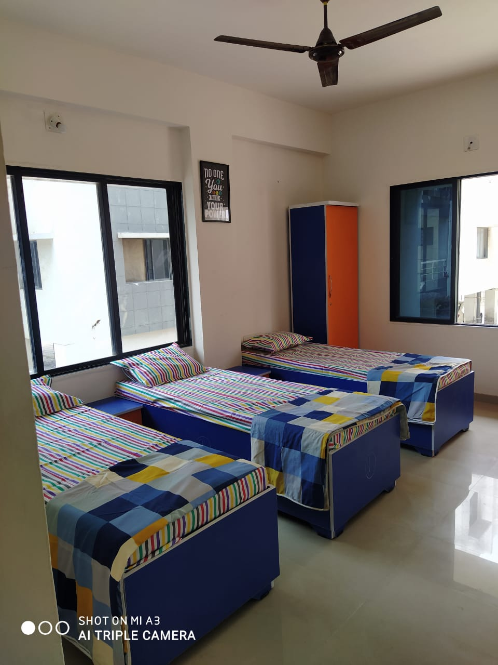
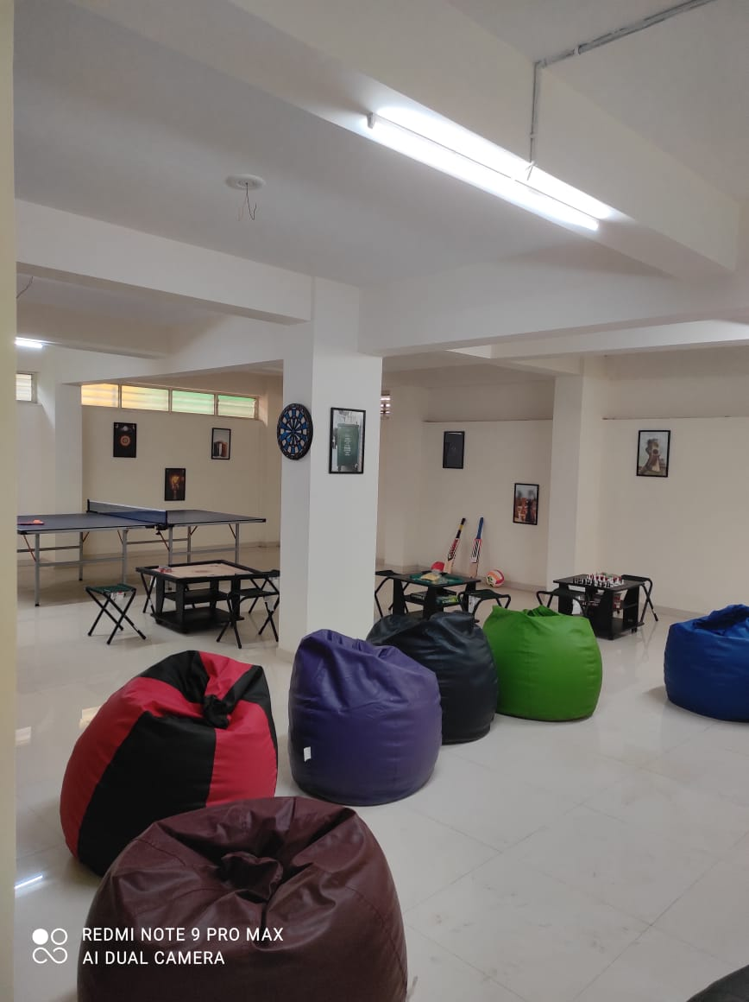
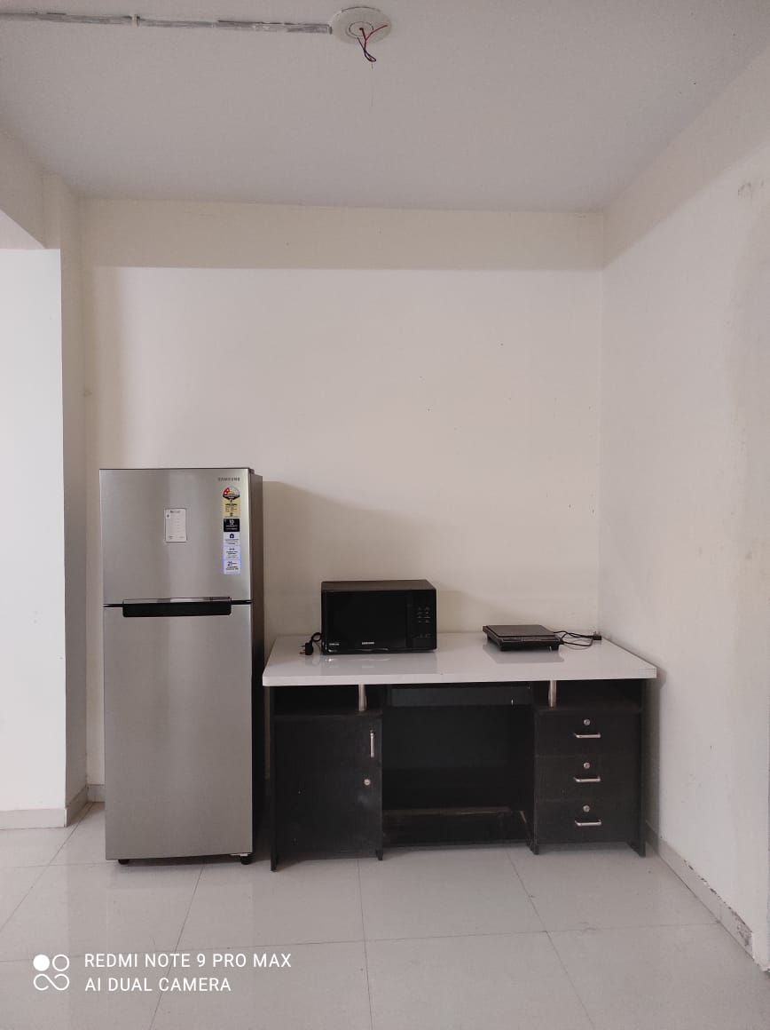
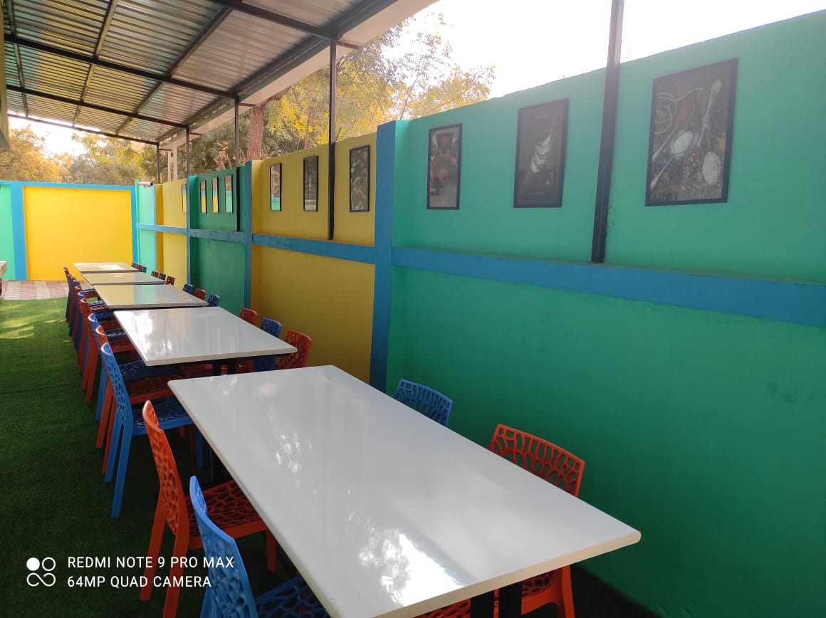
Product
A layer of accommodation services in C.A.R.T Model

Slide 6
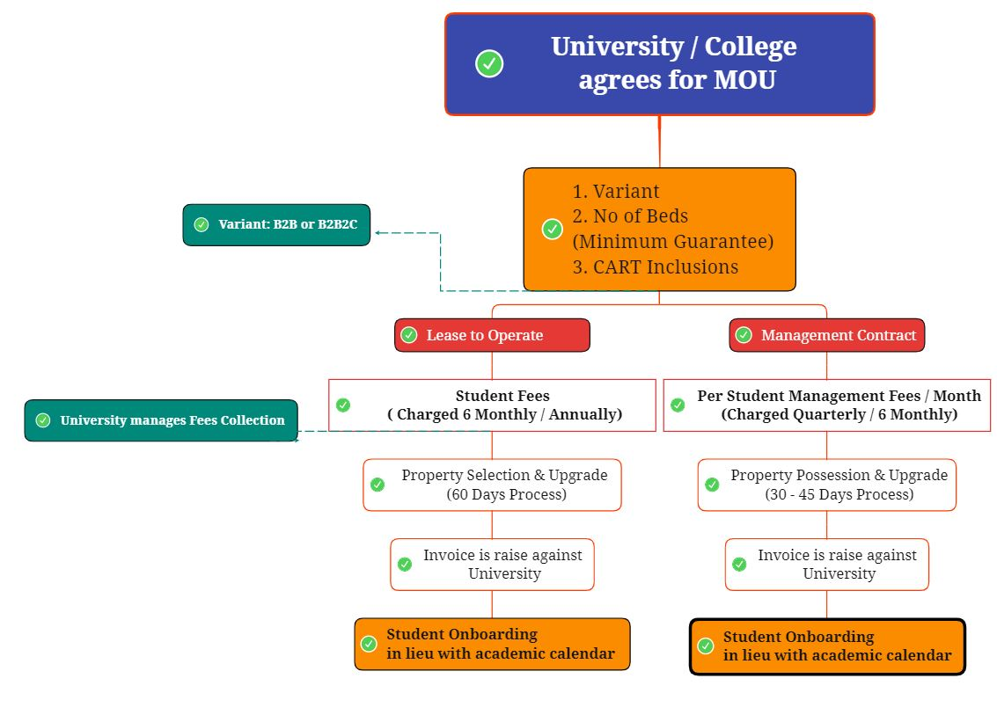
Business Model
How exactly?

Slide 7
Revenue Model
Direct & Indirect Revenue Sources
Deposits 1 month Rental as a refundable security deposit
Value Added Services, Community Model Top ups of Food, Laundry, Electricity, Transport
Cross Sales of Services including Canteen, Housekeeping College Canteen, Staff Meals, Campus Housekeeping
Use of Property for Off–Season (Vacation)
Summer Camps, Events, Short Stays, AirBnB
Subscription via Minimum Guarantee (Student Fees or Management Fees) Lease to Operate – 10500 / Month onwards
Management Contract – 6500 / Month onwards
Brand KhanePe, already established for College Canteens

Slide 8
Go To Market Strategy
How we will make in-roads?
 | Introduction & Early Days (Upto 1000 Beds) | Growth Stage (upto 4500 Beds)
Focus (Geographically & Size) | Ahmedabad, Rajkot, Gandhinagar Campuses with 75 – 350 Beds Capacity Both LTO & Management Contract Model (30:70 Ratio) | West & Central India (Including MP, Rajasthan & Maharashtra) Campuses with 400+ Beds Capacity Both LTO & Management Contract Model (30:70 Ratio)
Lead Identification | Already Identified | Few Identified
Lead Generation & Entry | Initial Negotiation & Discussion ON | Existing Clients Referral Business Development Activity including Cold Sales Strategy
Miscellaneous Activities | Warden Training Seminar / Webinar Sponsorships to College Clubs, Events, Awards & Societies PR Tactics | B-Plan / Case Studies Competition in Colleges College Placements & Internships Hostel Fund PR Tactics

Slide 9
Roadmap
2023
2025
2022
2024
2026
14000 + Beds
B Schools Schools
West & South India
Community Hostel Solution
30000 Beds
Senior Assisted Living
900+ Beds
Gujarat Only
4000+ Beds
West India

Slide 10
Market & Opportunity
Sky is the Limit
200 + IE, Autonomous Colleges
600+ Premium Residential Schools
Government Hostels, Skill Centres, Corporate Housing, Coaching – Entrance Institutes, Working Professional Hostels, Religious Community Hostels
1200 + Private Universities
250+ Incubators & Accelerators

Slide 11
Competitive Advantage
Inspiration & Competition
Features / Brand | RoomPe | Good Host Spaces | Your Space / Stanza Living
Category | Student Housing & Working Professional | Student Housing | Student Housing
Model | B2B & B2B2C | B2B | B2B & B2C
Working Model | LTO & Management Contract | Purchase & Operate | LTO
Focus | Universities & Corporate | Universities | Universities & Corporate
Community Feature | Exists | Does Not Exists | Semi Exists
Deep Penetration across Academic in West India
One of Very Few Brand in Management Contract Model
Community Feature
Cross Sales Product Bouquet
Tech enabled Operations

Slide 12
Traction
33 Odd Direct Jobs of Blue Collar Workforce
A Soft-Node for Closure of 1050 Beds for Academic year 2022 in Management Contract Model
5 College Canteens LOI & 2 Already running
1 Acquisition Offer from a Leading National Brand
4
Campuses associated are Nirma University, Navrachana University, AIIM, AIDTM
2
Cities RoomPe has operational properties
144
No of Beds with 95 – 98% Occupancy in B2B2C & B2B Model
ARR of 132 Lacs FY 2022-23

Slide 13
Competitive Advantage

Slide 14
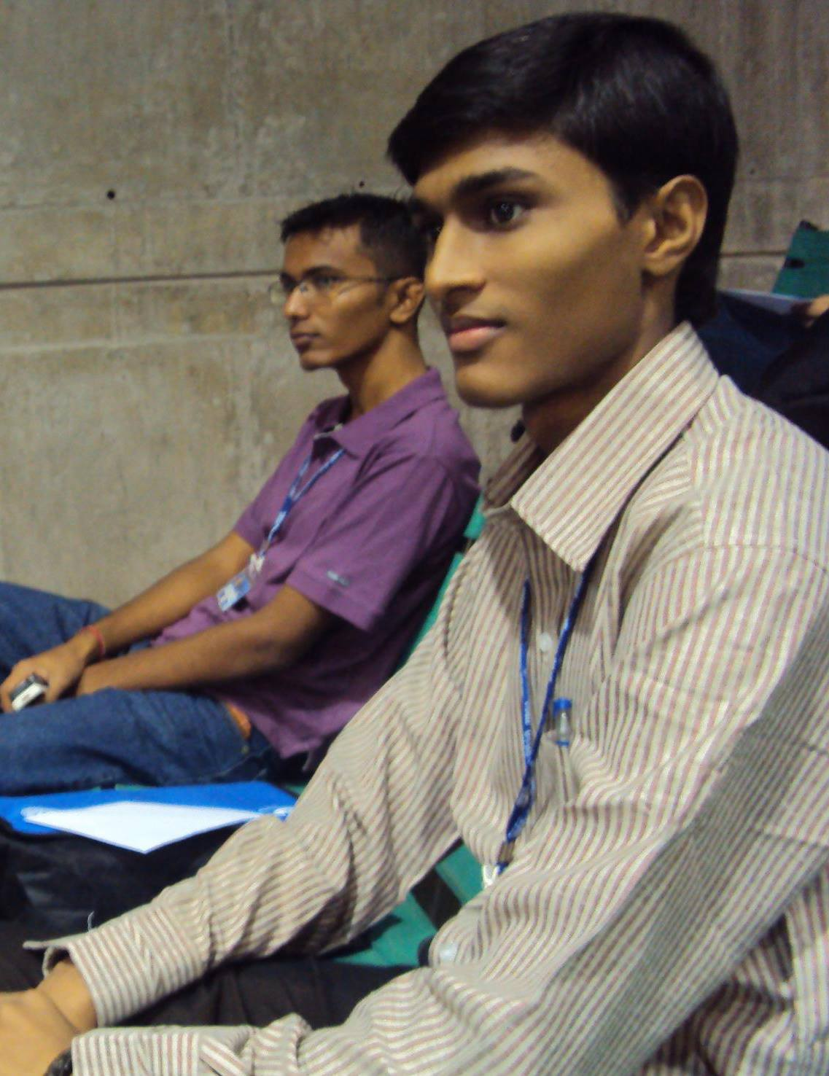
Team
We have a “strategic” plan its called doing things
Deval Patel & Satya Mehta
BBA (KSVV) & MBA (GTU) from same section, class, college, university and hostel room. Deval has a decade long experience in Operations & Purchase; Satya has a background in Education& Sales
Deval manages purchase, accounting & costs, operations, F&B
Satya manages Business Development, Product, HR & Outreach
26.11.2010: The Day, idea was discussed first time ever

Slide 15
Team
Deval Patel
Started career with IIFL (Gold Sales) as a Branch Head, went to Toyota India (Car Sales) & finally settled with Molex International for 8 Years in area of Operations, Purchase, & Customer Support
Satya Mehta
Started career as a commerce faculty post UGC-NET at a International School, went for Institutional and Franchise Sales for Schools and Pre School & finally settled with Endeavor Careers for 6 Years as National Sales Manager – UG Products
Supported & Mentored by
Jaykishan Fefar – CS
CFA Ravi Uttamchandani – Finances & Strategy
Hemang Patel – Strategy

Slide 16
Revenue Assumptions & Numbers
The minimum ticket size per bed are: (A) LTO Model – 10500 / Month (B) Management Contract – 7000 / Month; which are least possible (ticket size will be any day higher in actuals)
Per bed CAPEX investments considered are: (A) LTO Model – 40000 (B) Management Contract – 10000
Revenue from cross sales of services (college canteen – cafeteria, housekeeping) & VAS (top ups of food, housekeeping, laundry, community model) are not factored in the calculation
Per campus beds acquisition are again considered at a modest level; bigger the campus, better the numbers
Cities with multiple campuses of RoomPe facilities will have centralized deployment of food, Laundry, housekeeping, maintenance Staff

Slide 17
Ask & Proposal for Raising
Fund Callout (in Cr.) | Company Valuation (Pre Money) | 12.3 (Post Money)
₹ 2 | ₹ 10.2

Slide 18
Fund Usage
Usage | Amount | Remarks
Team | 400000 | 6 Month Salary of 10 Team Members
Capacity Building – Corporate | 1000000 | IT Infra & Setup of Departments
Capacity Building – Operations | 1000000 | Housekeeping, Security, & Internal SOPs
3 LTO Properties – 350 Beds | 12000000 | Generating Revenue of 48000000
Brand Makeover | 1000000 | Website, PR, Social Media & Marketing
Reach via current round
Usage | Amount
Existing – 140 Beds | 15,624,000
700 beds LOI | 50,400,000
3 LTO Properties – 350 Beds | 48,000,000
Additional 600 Beds via Management Contract | 43,200,000
Reinvestment from Free Cash Flow - 3 B2C - 450 Beds | 64,800,000
Grand Total | 222,024,000

Slide 19
Contact Details
Deval – 9904482107 | deval@roompe.co.in
Satya – 7990360056 | satya@roompe.co.in
www.roompe.co.in
Hostels – Student Accommodation – Corporate Accommodation – Remote Teams Stays

